Slide 1


Team 10: Smart Irrigation System
Team members: Matthew Eisen, Xavier Garza, Jack Hwang
Sponsor: Dr. John Lusher
TA: Eric Robles

Slide 2
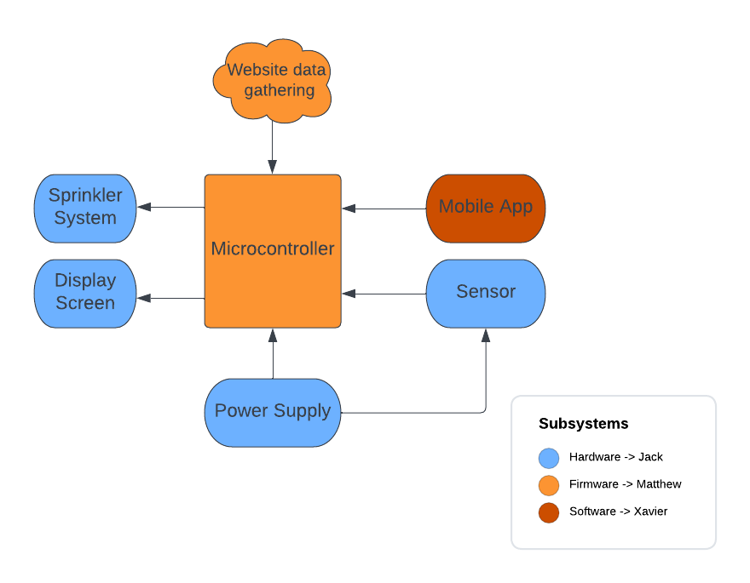
Team: Smart Irrigation System
A smart irrigation system that is able to anticipate and measure rainfall and prevent activation accordingly. It is both cost and water efficient while requiring minimal interaction from the owner. An app will also be available for maximum convenience to the owner.

Slide 3
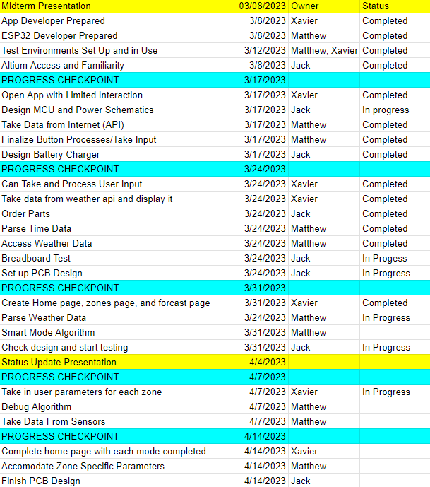
Team: Smart Irrigation System

Slide 4
Android Application Xavier Garza
Accomplishments since the last presentation <24> hrs | Ongoing progress/problems and plans until the next presentation
Created home screen, zones screen and forecast screen Use of open weather API to display forecast of any location Created zone setup | Implement mode selection and take in user parameters for simple mode Take in user parameters for each zone Implement manual mode

Slide 5
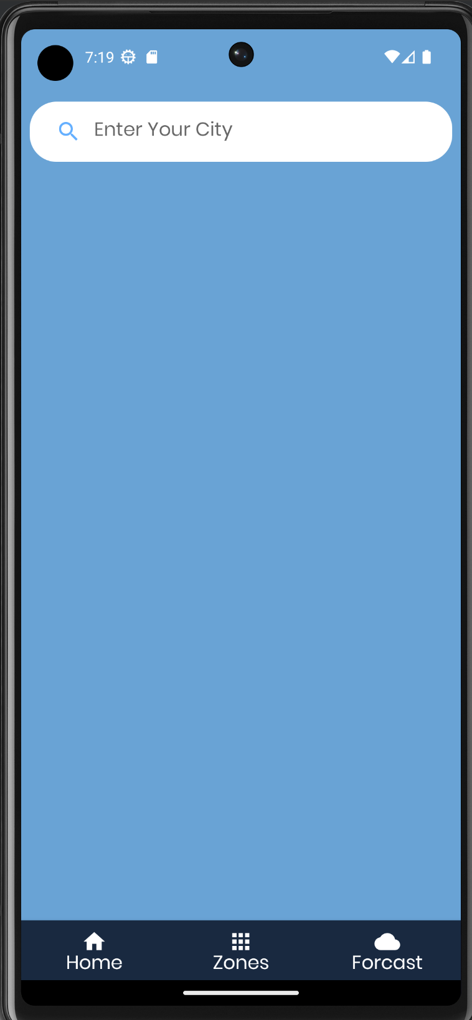
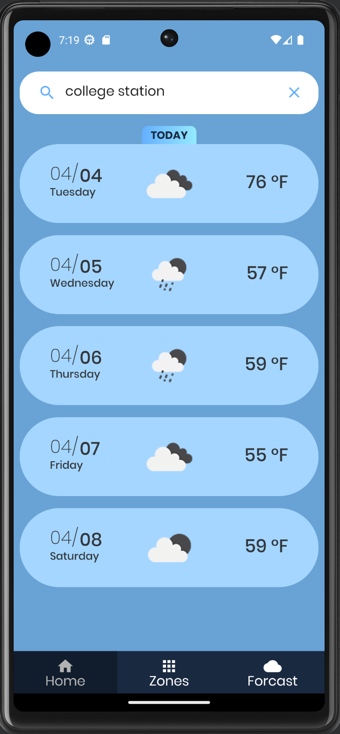
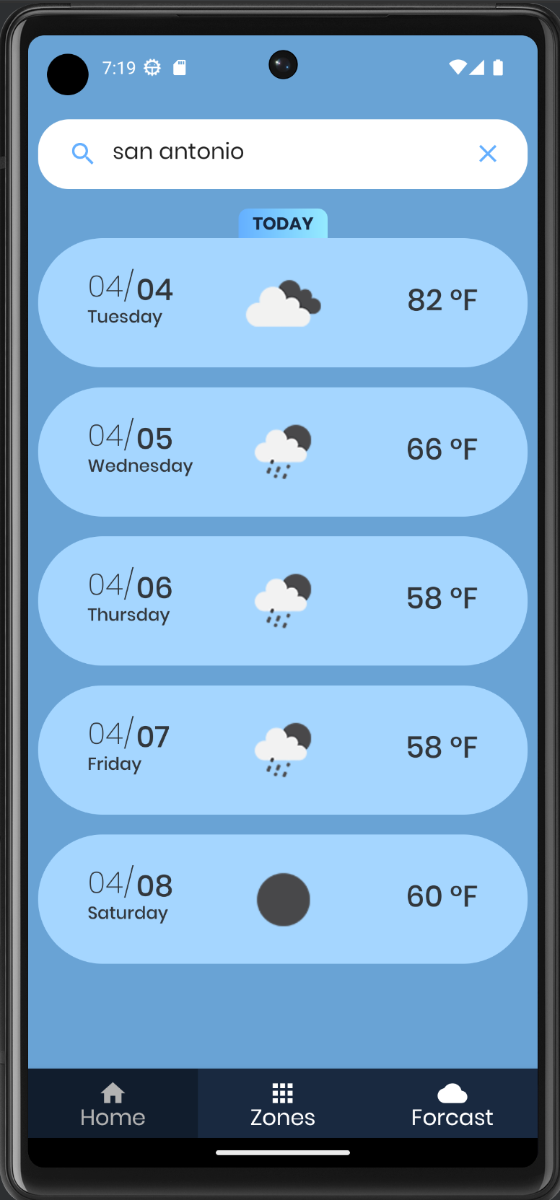
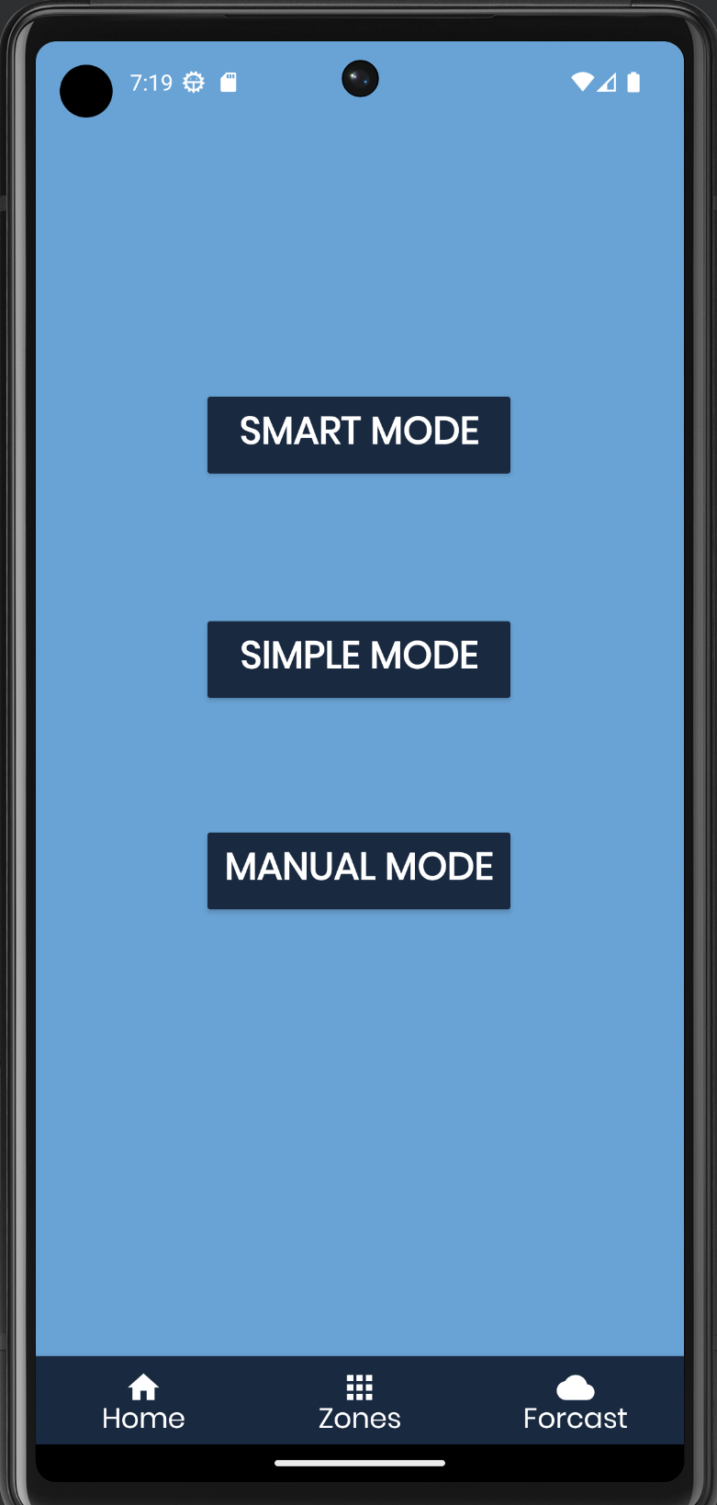
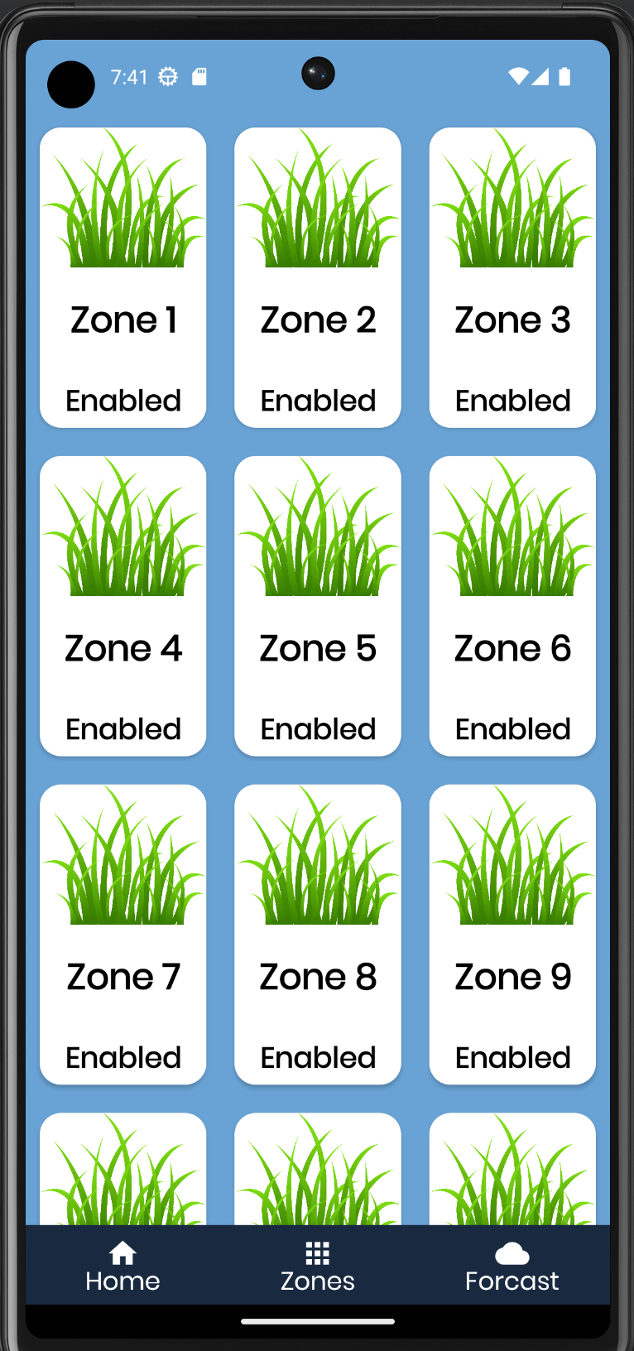
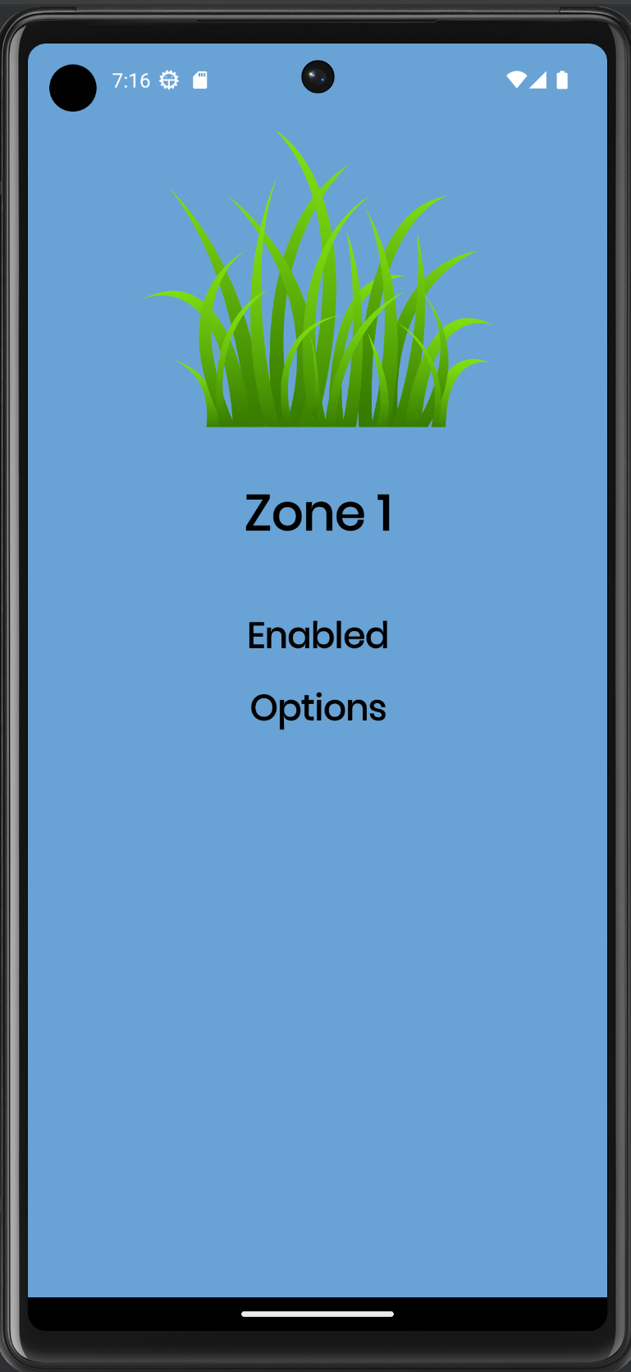

Slide 6
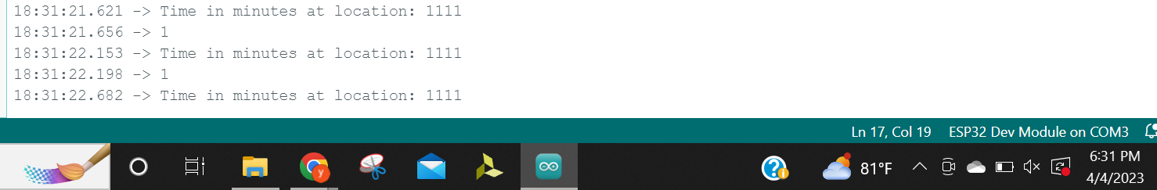
Firmware Matthew Eisen
Accomplishments since the last presentation <24> hrs | Ongoing progress/problems and plans until the next presentation
Find and connect to local wifi networks Acquire forecast and time data Parse time data into a single integer that can be compared (shown below) | Parsing forecast data Developing algorithm for smart mode to determine weather system runs or not Debugging breadboard testbench
Subsystem Picture, Sketch or Graph (1 per team member)

Slide 7
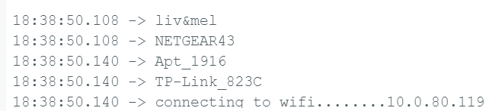
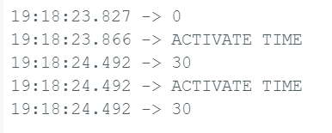
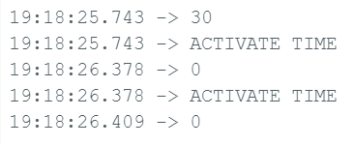
Firmware
Local WiFi networks
WiFi IP

Slide 8
Hardware Jack Hwang
Accomplishments since the last presentation <21> hrs | Ongoing progress/problems and plans until the next presentation
Completed creating MCU, Battery Charging Schematics/Design Started on PCB Design Almost finished with Power Converter design | Fix and tidy up Power Converter design Effectively test step down voltage to around 3.3V Complete PCB design Behind on where needed to be

Slide 9
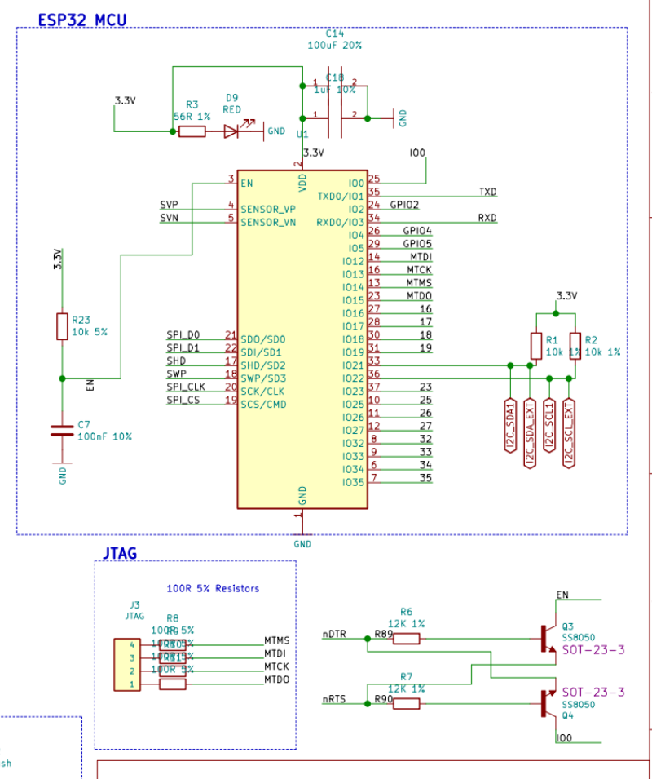
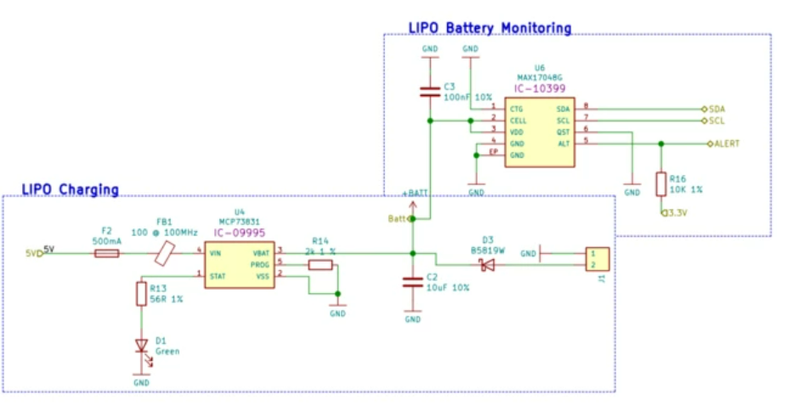
Hardware

Slide 10
Thank you!

